Slide 1
Capstone Project
Salary Prediction

Slide 2
Business Problem Understanding
Business Problem :
Eliminating Discrimination Between Employees with similar Profiles in terms of salary.
Minimise Human Judgement with regard to Salary.

Slide 3
Business Problem Understanding
Constraints :
Quality of Data: Categorical Features Like University_Grad, University_PG has Location Names which are not useful for Predicting.
There are missing values and Few outliers in the data

Slide 4
Business Problem Understanding
Scope of Salary Prediction Problem:
Pre-Processing the data to address the constraints.
Indentifying the relavent features that influence the salary prediction
Applying various Model and checking for the Performance Metrics like R2,RMSE,MAE and MAPE
Identifying the Best Model for Predicting Salary.

Slide 5
Business Problem Understanding
Objectives:
Minimising Human Bias
Improving the recruitment process by incorporating the Predictive models for fair salary prediction

Slide 6
Modelling Approaches Used and Why
Linear Regression:Linear regression is straightforward and provides easily interpretable coefficients that show the relationship between the features and the target variable.
Lasso Regression:Lasso Regression is the Extension of Linear Regression. Lasso regression performs L1 regularization, which can shrink some coefficients to zero, effectively selecting a simpler model that may generalize better
Decission Tree:Splits data into subsets based on feature values, Can capture complex interactions between features, Does not require feature scaling

Slide 7
Modelling Approaches Used and Why
Gradiant Boost Ensemble Model:Sequentially builds models to correct errors of previous models, Can handle both linear and non-linear relationships, Often requires careful tuning of hyperparameters.
XG Boost Regressor:An optimized implementation of gradient boosting, Handles missing data well and can be parallelized.
Random Forest Regressor:Combines multiple decision trees to improve predictive performance and reduce overfitting.

Slide 8
Performance Metrics :
Model | Dataset | R-Square | MAE | MAPE
Linear Regression | Train | 0.9957 | 50733 | 0.0421
 | Test | 0.9958 | 50441 | 0.0412
Lasso Regression | Train | 0.9957 | 50731 | 0.0421
 | Test | 0.9958 | 50438 | 0.0412
Decission Tree | Train | 0.9994 | 3304 | 0.0053
 | Test | 0.9990 | 13834 | 0.0121
Gradiant Boost Ensemble Model | Train | 0.9982 | 27880 | 0.0214
 | Test | 0.9982 | 27929 | 0.0205
XG Boost Regressor | Train | 0.9993 | 11177 | 0.0100
 | Test | 0.9992 | 13362 | 0.0112
Random Forest Regressor | Train | 0.9994 | 6866 | 0.0076
 | Test | 0.9992 | 12525 | 0.0112

Slide 9
Insights from Analysis
The data contains 25000 rows and 29 attributes.
Key Performer,A,B Appraisal rating applicants Expected_ CTC more compared to others.
Fresher Applications are Very Less compared to Experienced and Expected_CTC is also low w.r.to Experienced

Slide 10
Insights from Analysis
Bio-Statician Applications are more compared to other Roles
Education: PG & Doctorates have High Expected _CTC than Grad and Under_grads.
Marketing department has more applicants followed by Analytics/BI.

Slide 11
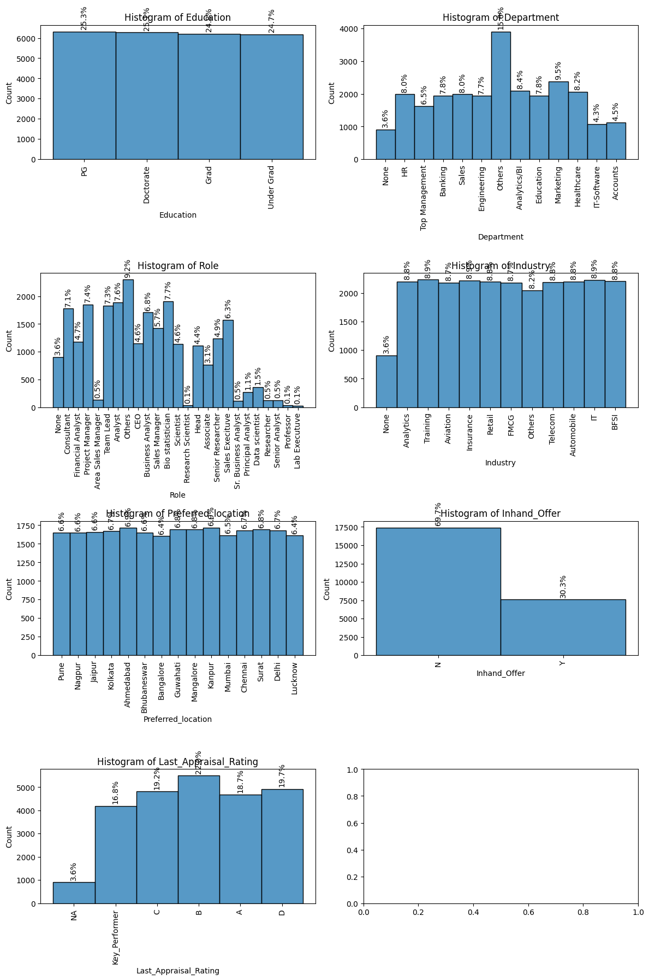

Slide 12
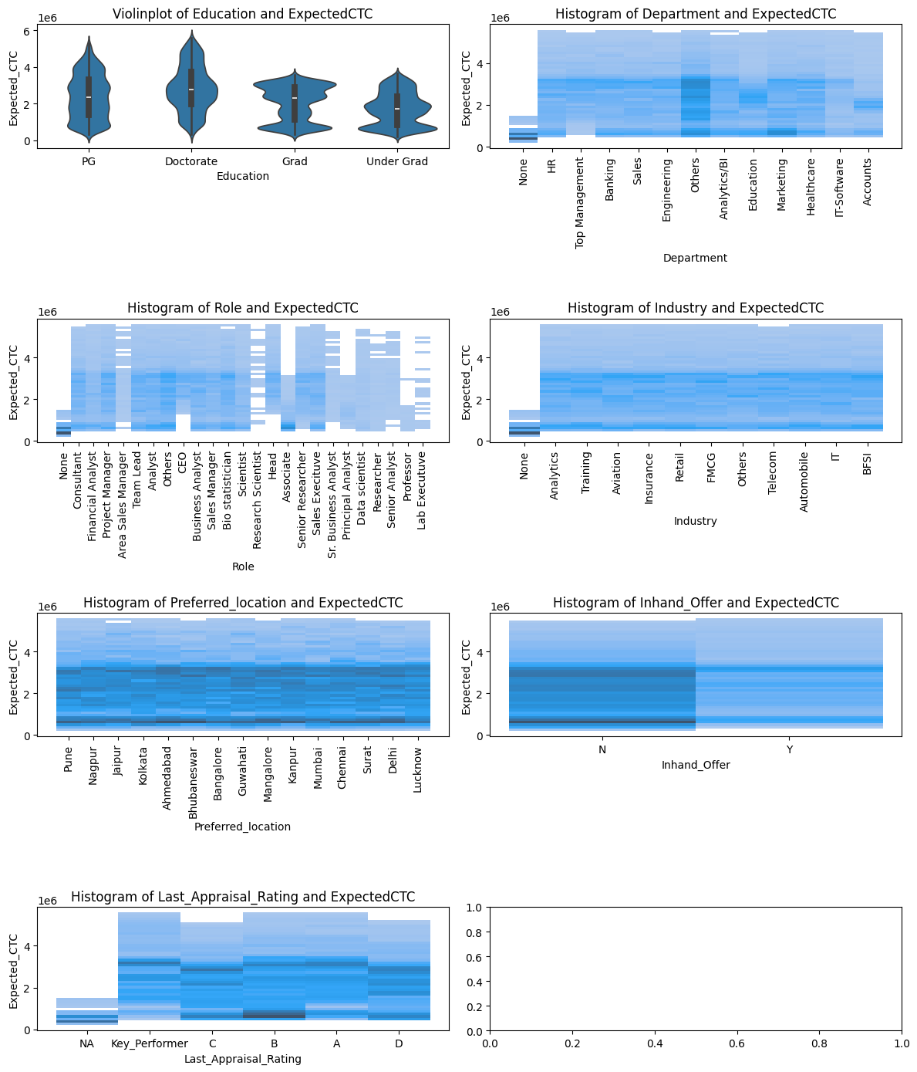

Slide 13
Recommendations
Random Forest Regressor Model is Able to Predict Salary More accurately Compared to Other Models.
Total Experience,Total Experience in field Applied,Current CTC,Inhand Offer,No of Companies worked,No of Publications,Certifications,International Degree any,Expected CTC,Department,Role,Industry,Education,Last Appraisal Rating these are the features that are important for fair salary predictions.

Slide 14
Thankyou

